Slide 1
Computer Architecture
A Quantitative Approach, Sixth Edition
Chapter 4
Data-Level Parallelism in Vector, SIMD, and GPU Architectures

Slide 2
Introduction
Introduction
SIMD architectures can exploit significant data-level parallelism for:
Matrix-oriented scientific computing
Media-oriented image and sound processors
SIMD is more energy efficient than MIMD
Only needs to fetch one instruction per data operation
Makes SIMD attractive for personal mobile devices
SIMD allows programmer to continue to think sequentially

Slide 3
SIMD Parallelism
Introduction
Vector architectures
SIMD extensions
Graphics Processor Units (GPUs)
For x86 processors:
Expect two additional cores per chip per year
SIMD width to double every four years
Potential speedup from SIMD to be twice that from MIMD!

Slide 4
Vector Architectures
Vector Architectures
Basic idea:
Read sets of data elements into “vector registers”
Operate on those registers
Disperse the results back into memory
Registers are controlled by compiler
Used to hide memory latency
Leverage memory bandwidth

Slide 5
VMIPS
Vector Architectures
Example architecture: RV64V
Loosely based on Cray-1
32 64-bit vector registers
Register file has 16 read ports and 8 write ports
Vector functional units
Fully pipelined
Data and control hazards are detected
Vector load-store unit
Fully pipelined
One word per clock cycle after initial latency
Scalar registers
31 general-purpose registers
32 floating-point registers

Slide 6
RV64V

Slide 7
VMIPS Instructions
Vector Architectures
.vv: two vector operands
.vs and .sv: vector and scalar operands
LV/SV: vector load and vector store from address
Example: DAXPY (Y=a*X+Y) D=double precision
vsetdcfg 4*FP64 # Enable 4 DP FP vregs
fld f0,a # Load scalar a
vld v0,x5 # Load vector X
vmul v1,v0,f0 # Vector-scalar mult
vld v2,x6 # Load vector Y
vadd v3,v1,v2 # Vector-vector add
vst v3,x6 # Store the sum
vdisable # Disable vector regs
8 instructions, 258 for RV64V (scalar code)

Slide 8
RISC-V code

Slide 9
Vector Execution Time
Vector Architectures
Execution time depends on three factors:
Length of operand vectors
Structural hazards
Data dependencies
RV64V functional units consume one element per clock cycle
Execution time is approximately the vector length
Convoy
Set of vector instructions that could potentially execute together

Slide 10
Chimes
Vector Architectures
Sequences with read-after-write dependency hazards placed in same convoy via chaining
Chaining
Allows a vector operation to start as soon as the individual elements of its vector source operand become available
Chime
Unit of time to execute one convoy
m convoys executes in m chimes for vector length n
For vector length of n, requires m x n clock cycles

Slide 11
Example
Vector Architectures
vld v0,x5 # Load vector X
vmul v1,v0,f0 # Vector-scalar multiply
vld v2,x6 # Load vector Y
vadd v3,v1,v2 # Vector-vector add
vst v3,x6 # Store the sum
Convoys:
1 vld vmul
2 vld vadd
3 vst
3 chimes, 2 FP ops per result, cycles per FLOP = 1.5
For 32 element vectors, requires 32 x 3 = 96 clock cycles

Slide 12
Challenges
Vector Architectures
Start up time
Latency of vector functional unit
Assume the same as Cray-1
Floating-point add => 6 clock cycles
Floating-point multiply => 7 clock cycles
Floating-point divide => 20 clock cycles
Vector load => 12 clock cycles
Improvements:
> 1 element per clock cycle
Non-64 wide vectors
IF statements in vector code
Memory system optimizations to support vector processors
Multiple dimensional matrices
Sparse matrices
Programming a vector computer

Slide 13
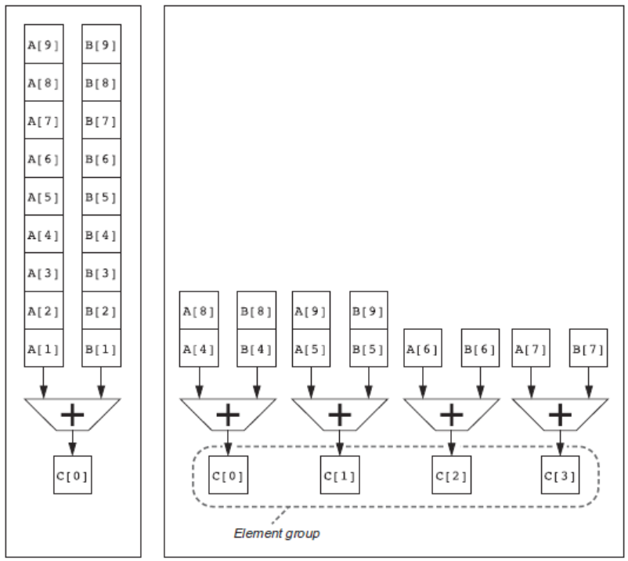
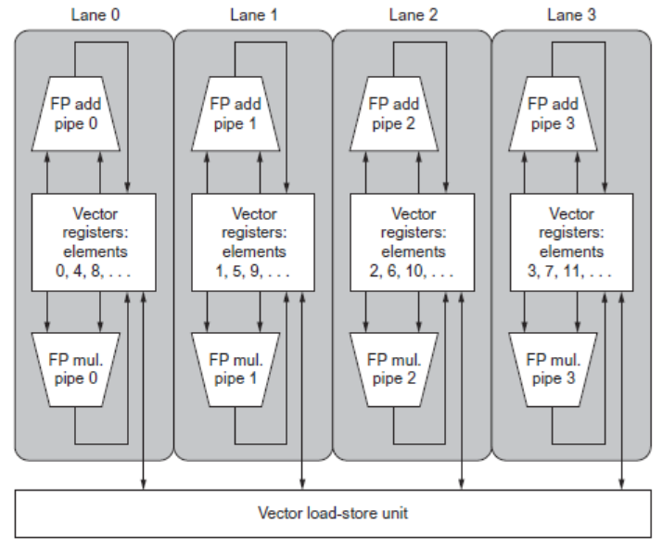
Multiple Lanes
Vector Architectures
Element n of vector register A is “hardwired” to element n of vector register B
Allows for multiple hardware lanes

Slide 14
Memory Banks
Vector Architectures
Memory system must be designed to support high bandwidth for vector loads and stores
Spread accesses across multiple banks
Control bank addresses independently
Load or store non sequential words (need independent bank addressing)
Support multiple vector processors sharing the same memory
Example:
32 processors, each generating 4 loads and 2 stores/cycle
Processor cycle time is 2.167 ns, SRAM cycle time is 15 ns
How many memory banks needed?
32x(4+2)x15/2.167 = ~1330 banks

Slide 15
Graphical Processing Units
Basic idea:
Heterogeneous execution model
CPU is the host, GPU is the device
Develop a C-like programming language for GPU
Unify all forms of GPU parallelism as CUDA (Compute Unified Device Architecture) thread
Programming model is “Single Instruction Multiple Thread”
Graphical Processing Units

Slide 16
Threads and Blocks
A thread is associated with each data element
Threads are organized into blocks
Blocks are organized into a grid
GPU hardware handles thread management, not applications or OS
Graphical Processing Units

Slide 17
NVIDIA GPU Architecture
Similarities to vector machines:
Works well with data-level parallel problems
Scatter-gather transfers
Mask registers
Large register files
Differences:
No scalar processor
Uses multithreading to hide memory latency
Has many functional units, as opposed to a few deeply pipelined units like a vector processor
Graphical Processing Units

Slide 18
Example
Code that works over all elements is the grid
Thread blocks break this down into manageable sizes
512 threads per block
SIMD instruction executes 32 elements at a time
Thus grid size = 16 blocks
Block is analogous to a strip-mined vector loop with vector length of 32
Block is assigned to a multithreaded SIMD processor by the thread block scheduler
Current-generation GPUs have 7-15 multithreaded SIMD processors
Graphical Processing Units

Slide 19
Terminology
Each thread is limited to 64 registers
Groups of 32 threads combined into a SIMD thread or “warp”
Mapped to 16 physical lanes
Up to 32 warps are scheduled on a single SIMD processor
Each warp has its own PC
Thread scheduler uses scoreboard to dispatch warps
By definition, no data dependencies between warps
Dispatch warps into pipeline, hide memory latency
Thread block scheduler schedules blocks to SIMD processors
Within each SIMD processor:
32 SIMD lanes
Wide and shallow compared to vector processors
Graphical Processing Units

Slide 20
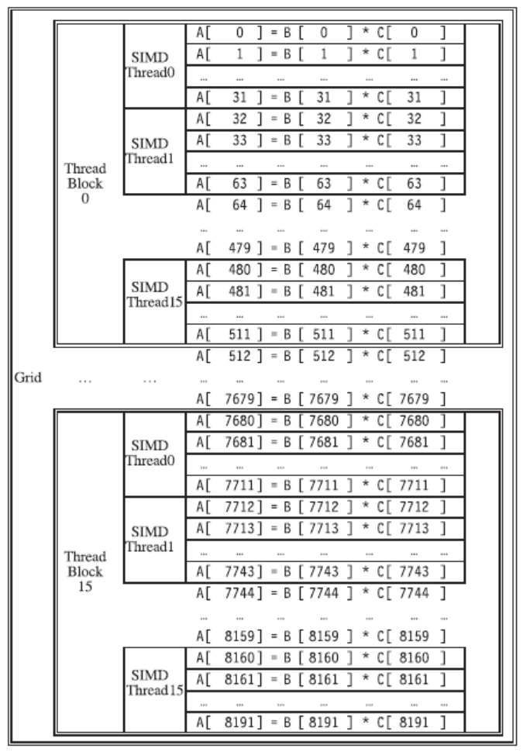
Example
Graphical Processing Units

Slide 21
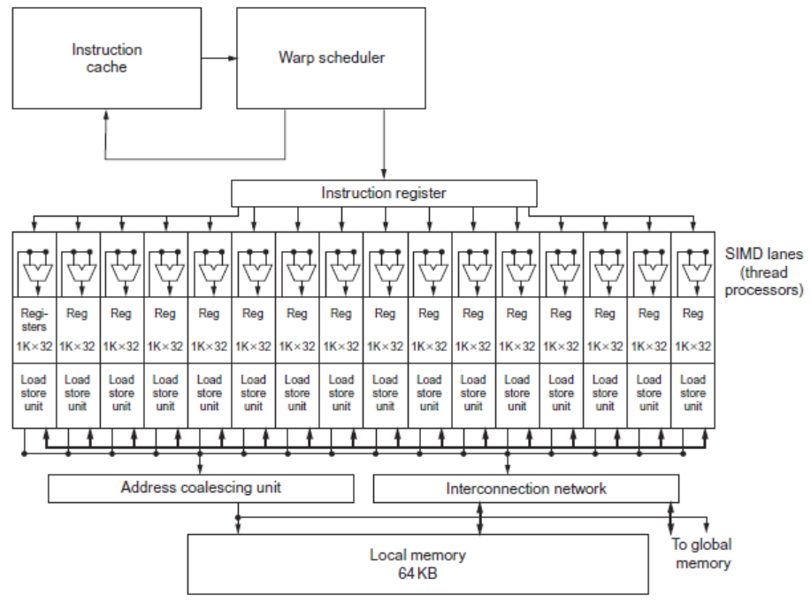
GPU Organization
Graphical Processing Units

Slide 22
NVIDIA GPU Memory Structures
Each SIMD Lane has private section of off-chip DRAM
“Private memory”
Contains stack frame, spilling registers, and private variables
Each multithreaded SIMD processor also has local memory
Shared by SIMD lanes / threads within a block
Memory shared by SIMD processors is GPU Memory
Host can read and write GPU memory
Graphical Processing Units

Slide 23
Pascal Architecture Innovations
Each SIMD processor has
Two or four SIMD thread schedulers, two instruction dispatch units
16 SIMD lanes (SIMD width=32, chime=2 cycles), 16 load-store units, 4 special function units
Two threads of SIMD instructions are scheduled every two clock cycles
Fast single-, double-, and half-precision
High Bandwith Memory 2 (HBM2) at 732 GB/s
NVLink between multiple GPUs (20 GB/s in each direction)
Unified virtual memory and paging support
Graphical Processing Units

Slide 24
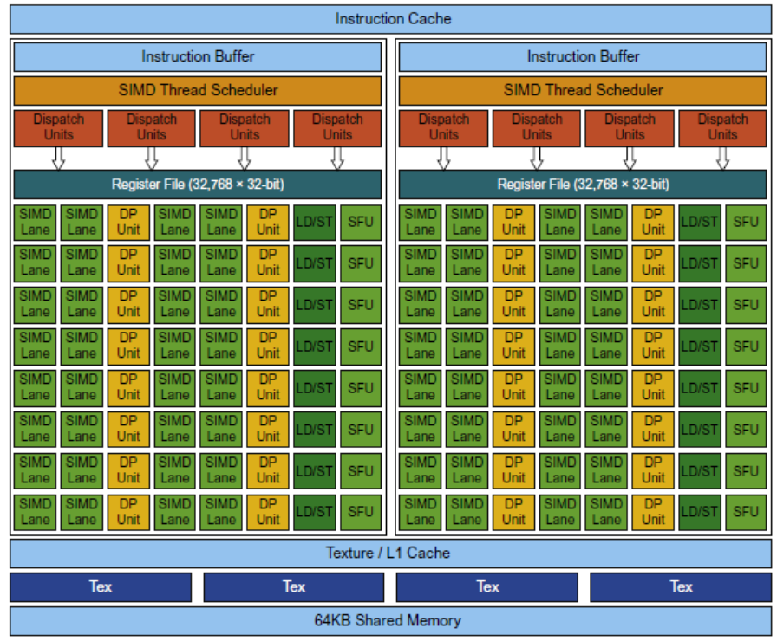
Pascal Multithreaded SIMD Proc.
Graphical Processing Units

Slide 25
Vector Architectures vs GPUs
SIMD processor analogous to vector processor, both have MIMD
Registers
RV64V register file holds entire vectors
GPU distributes vectors across the registers of SIMD lanes
RV64 has 32 vector registers of 32 elements (1024)
GPU has 256 registers with 32 elements each (8K)
RV64 has 2 to 8 lanes with vector length of 32, chime is 4 to 16 cycles
SIMD processor chime is 2 to 4 cycles
GPU vectorized loop is grid
All GPU loads are gather instructions and all GPU stores are scatter instructions
Graphical Processing Units

Slide 26
SIMD Architectures vs GPUs
GPUs have more SIMD lanes
GPUs have hardware support for more threads
Both have 2:1 ratio between double- and single-precision performance
Both have 64-bit addresses, but GPUs have smaller memory
SIMD architectures have no scatter-gather support
Graphical Processing Units

Slide 27
Loop-Level Parallelism
Focuses on determining whether data accesses in later iterations are dependent on data values produced in earlier iterations
Loop-carried dependence
Example 1:
for (i=999; i>=0; i=i-1)
x[i] = x[i] + s;
No loop-carried dependence
Detecting and Enhancing Loop-Level Parallelism

Slide 28
Loop-Level Parallelism
Example 2:
for (i=0; i<100; i=i+1) {
A[i+1] = A[i] + C[i]; /* S1 */
B[i+1] = B[i] + A[i+1]; /* S2 */
}
S1 and S2 use values computed by S1 in previous iteration
S2 uses value computed by S1 in same iteration
Detecting and Enhancing Loop-Level Parallelism

Slide 29
Loop-Level Parallelism
Example 3:
for (i=0; i<100; i=i+1) {
A[i] = A[i] + B[i]; /* S1 */
B[i+1] = C[i] + D[i]; /* S2 */
}
S1 uses value computed by S2 in previous iteration but dependence is not circular so loop is parallel
Transform to:
A[0] = A[0] + B[0];
for (i=0; i<99; i=i+1) {
B[i+1] = C[i] + D[i];
A[i+1] = A[i+1] + B[i+1];
}
B[100] = C[99] + D[99];
Detecting and Enhancing Loop-Level Parallelism

Slide 30
Loop-Level Parallelism
Example 4:
for (i=0;i<100;i=i+1) {
A[i] = B[i] + C[i];
D[i] = A[i] * E[i];
}
Example 5:
for (i=1;i<100;i=i+1) {
Y[i] = Y[i-1] + Y[i];
}
Detecting and Enhancing Loop-Level Parallelism

